Slide 1
Service Consumer Patterns
How to talk to microservices.

Slide 2
Agenda
What is a Microservice?
What is a Service Consumer?
API Composition
Conversations
Guidance

Slide 3
What is a Microservice?

Slide 4
SOA
Compatibility by Policy
Direct
Bookings
API
Services are Autonomous
Boundaries are Explicit
Single Writer
Db
Share Schema not Type
Notes:
Microservices: SOA -> Guerilla SOA (Jim Webber) -> Microservices (Fred George – Programmer Anarchy)
Fowler and Lewis: Microservices -> Much more Jim Webber Guerilla SOA than Fred George “I sing the body microservices”
Services: hide code and data, expose only documented message formats for communication
Decoupling is the reason for this.
Depend upon abstractions, don’t depend on details
4 tenets of SOA, still applicable to microservices
Boundaries are explicit
Services are autonomous
Share Schema Not Type
Compatibility is based on Policy
But adds some new relevant ones like Bounded Context (a CI boundary)
A service is the ‘system of record’ for some part of our system
There is only a single writer of that data - this service
Often a service owns a bounded context, not just one entity or aggregate
Everyone else must ask the service for data, or listen to the service for data
Although we clearly own create, update, and delete it can be a little less obvious that we own Read.
Remember that we are trying to reduce coupling between services to allow independent deployment, so we don’t want to share schema out of the service. So our read is a stable contract, a view of our data. Because downstream clients may be hard to change, and we might want to restructure around new capabilities or algorithms then we need to insulate our internals from the external read data, and ensure that whilst that is long-lived it is not limiting our ability to change our internals

Slide 5
What is a microservice?
SOA is focused on business processes. These processes are performed in different steps (also called activities or tasks) on different systems. The primary goal of a service is to represent a “natural” step of business functionality. That is, according to the domain for which it’s provided, a service should represent a self-contained functionality that corresponds to a real-world business activity.
Josuttis, Nicolai M.. SOA in Practice: The Art of Distributed System Design . O'Reilly Media. Kindle Edition.
Notes:
Whilst this is SOA advice, we are taking the view that microservices are just SOA 3.0, and as such, most of the best practice still applies
The key here is to understand that we want service alignment with a business process or activity. Whilst services offer us benefits such as fault-tolerance through isolation, that is not the thrust of this workstream. Instead this workstream is looking at how microservices improve our productivity, when we get alignment between a service and a business process.
We amplify this point in the next slide, which talks about the entity service anti-pattern

Slide 6
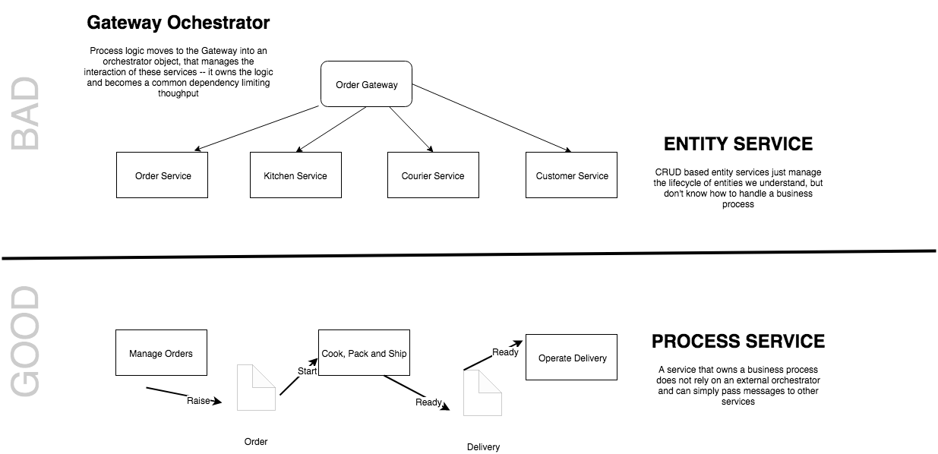
The Entity Service Sniff Test
See Avoiding the Entity Service, Michael Nygard
Notes:
We need to be cautious of modeling microservices by looking for entities in our system and wrapping them with an API. This model tends to result in ‘feature envy’ as the business process logic creeps out of the service and into a Gateway orchestrator. Often this creates temporally coupled services, or the need to copy a lot of data in projections between services. By focusing on a process we can make our services more self-contained and more effectively use messaging to communicate.
Sometimes things just are an entity service, but they tend to be sources of reference data cached locally by other services to do their work

Slide 7
What is a Service Consumer?

Slide 8
Endpoint
Binds To
Serves
Exposes
Contract
Consumes
Implements
Service Consumer
Service
Connects Via
Sends/Receives
Sends/Receives
Binding
Adheres To
Requires
Policy
After SOA Patterns Arnon Rotem-Gal-Oz
Notes:
A service consumer consumes the API exposed by a service. To consumer a service we need to understand the ABCs (Address, Binding, and Contract)
Endpoint: Where does the service expose the API, a URI, an AMQP URN, or an AWS ARN etc.
Contract: What is the API that we expose and consume. This should be stable, as it is a dependency of downstream consumers.
Binding: The contract is exposed via protocol such as HTTP or AMQP. It might be exposed by more than one. Consumers need to be able to send and receive via this.
Policy: On top of the binding there may be rules we wish to enforce, such as authentication that we need to conform to.

Slide 9
Getting work done in a Monolith
API
Presentation
Direct
Bookings
Credit Card
Payments
Accounts
Housekeeping
Channel Manager
Domain
ORM
Data
Db
Notes:
In a typical monolithic application, we might divide up our system into three layers.
Presentation: The widgets, in this case our HTTP API, but might it might have been server-side rendered HTML etc.
Domain: The application and domain logic
Data: Access to our persistent storage
Let us imagine that we have a request for a direct booking on account. To service this request, we would probably call some application logic in a service/command in direct bookings (1). The application logic there would load the data we needed to complete the operation, so the account details with the credit card information 2-5), so that we could then take a credit card payment (6-7). In turn we would then save the direct booking (8) andl probably call Housekeeping and Channel Manager to update their records of the number of available rooms.

Slide 10
Partner
Client
Perimeter
Process Manager
API Gateway
Gateway
BFF
Direct
Bookings
Credit Card
Payments
Accounts
Housekeeping
Channel Manager
API
API
API
API
API
Db
Db
Db
Db
Db
Bus
Notes:
We can think about a microservice architecture as possessing a number of layers.
Client: Native, Web or User Agent, but also partner organizations using APIs from outside the perimeter
Perimeter: The line between internal and external systems
Gateway: A microservice is oriented around a business function, and owns its own data.
A lot of the time the microservice provides cross-cutting concerns such as authentication and TLS termination, but otherwise just acts as a proxy over the APIs
Sometimes we need to choreograph across multiple microservices
1: We need to combine data from multiple microservices to answer a query – API Gateway or BFF (client or partner specific)
2: We want to orchestrate the interaction of microservices to react to a command – Process Manager (also called a Saga or Orchestrator)
Microservices: A self-contained service that corresponds to a business process
Bus: Integration between microservices via a publish-subscribe model

Slide 11
Partner
Client
We are going to talk mostly about these patterns
Perimeter
Process Manager
API Gateway
Gateway
BFF
Direct
Bookings
Credit Card
Payments
Accounts
Housekeeping
Channel Manager
API
API
API
API
API
Db
Db
Db
Db
Db
We cover the other patterns in another talk
Bus
Notes:
We can think about a microservice architecture as possessing a number of layers.
Client: Native, Web or User Agent, but also partner organizations using APIs from outside the perimeter
Perimeter: The line between internal and external systems
Gateway: A microservice is oriented around a business function, and owns its own data.
A lot of the time the microservice provides cross-cutting concerns such as authentication and TLS termination, but otherwise just acts as a proxy over the APIs
Sometimes we need to choreograph across multiple microservices
1: We need to combine data from multiple microservices to answer a query – API Gateway or BFF (client or partner specific)
2: We want to orchestrate the interaction of microservices to react to a command – Process Manager (also called a Saga or Orchestrator)
Microservices: A self-contained service that corresponds to a business process
Bus: Integration between microservices via a publish-subscribe model

Slide 12
API Composition

Slide 13
Partner
Client
Perimeter
Process Manager
API Gateway
Gateway
BFF
?
Accounts
Housekeeping
API
API
Check-In
Db
Db
Bus
Notes:
Scenario: we want to retrieve the customer’s reservation details at the front desk. The front desk asks for the reservation, but we want to know some customer details if it is an account booking such as their name, credit card on file, preferences, rewards etc. But those live in the account system. How do we display them?
Do we need to call the accounts system as well as the housekeeping system?

Slide 14
Reference Data
GET /booking/12345 HTTP 1.1
Cache-Control: max-age=30
If-Modified-Since: Fri 19 April 2019 09:00 GMT
Pat Helland
Compatibility by Policy
Direct
Bookings
API
Outside Data
Services are Autonomous
Immutable, stale, versioned
Boundaries are Explicit
Single Writer
Db
Booking.Created.Event
Message-Id: aa95b387-a17f-4907-a1d8-e597c322bfc6
Correlation-Id: d060cb3f-ec71-4257-b5c8-819d1a9ca6cb
{ items : [Booking {…}]}
Inside Data
Share Schema not Type
Notes:
But we must share state in order to function – if no one talks to us we are not a microservice, we are just a small piece of standalone software
This is request-oriented or event-oriented e.g. we a REST API or events
Pat Helland calls the data that we are the system of record for Data on the Inside.
Helland calls the data that flows to other applications in this way, response or message body is Data on the Outside.
Data on the Outside risks being ‘stale’ as soon as we publish it. Any further changes to the Data on the Inside will render what we just published ’stale’.
Data on the Outside must be versioned or timestamped so that we know how ’fresh’ it is, and whether other data we have is newer or older.

Slide 15

Event Carried
State Transfer
GET /reservations/1234 HTTP 1.1
Martin Fowler
Web
Accounts
Housekeeping
Read Customer info
Operand Data
Worker
Read Reservation Details
Accounts Ref Db
Housekeeping Db

Slide 16
Partner
Client
Perimeter
Process Manager
API Gateway
Gateway
BFF
Direct
Bookings
Channel Manager
API
API
Channel Effectiveness
Db
Db
Notes:
Scenario: we want to combine referrer data from Direct Bookings with channel manager data about pricing, offers etc. to determine effectiveness of our channels

Slide 17
Event Carried
State Transfer
GET /channel/1234 HTTP 1.1
Martin Fowler
Web
Direct Bookings
Channel Effectiveness
Composite View Model/Historic Artefacts
Worker
Channel Manager
Read Effectiveness
Channel Effectiveness Db
Notes:
We can use a composite view model, building it from multiple events
Hint: This is what a Data Lake does, we can do it through the lake, or in some cases build our own model

Slide 18
Partner
Client
Perimeter
Process Manager
API Gateway
Gateway
BFF
?
Direct Booking
Property Services
API
API
Group Room Search
Db
Db
Bus
Notes:
Scenario: we want to search across all our hotels, in a geographic region, such as a city, to look for available rooms at the time of the customer’s booking. If we can’t fit them in the budget hotel is their room in our upscale hotel?

Slide 19
Partner
Client
Perimeter
Process Manager
API Gateway
Gateway
BFF
Direct Booking
Property Services
API
API
Group Room Search
Db
Db
Bus
Notes:
This is when we compose the call instead

Slide 20
Partner
Client
Proxy
We are using a ‘proxy’ to manage API calls
API
The Proxy provides a Composite API that our client code uses
Gateway or Client
(conceptually forward or reverse)
Direct Booking
Property Services
API
API
Composition
Db
Db
Bus
Notes:
The composer is just a proxy. It may be on the server or the client. It exposes a shape of API itself. It combines the results of the underlying API calls.
On the server this is technically a Gateway. It can handle Retry/Circuit Breaker and observability
GraphQL may have a value here i.e. Apollo

Slide 21
Partner
Client
Proxy can own retry/circuit breaker/rate limiting
Proxy
On the server, it may provide cross-cutting concerns:
TLS termination
Authentication
…
May load balance over a group of instances for availability
Direct Booking
API
Proxy/Gateway
BFF is just tailored to one consumer only
Db
Bus
Notes:
A proxy has other use cases
Could be North-South or East-West

Slide 22
Config
Discovery
Monitoring
Policy
Control Plane
Data Plane
Proxy
Proxy
Proxy
Proxy
Direct
Bookings
Credit Card
Payments
Housekeeping
Channel Manager
Direct
Bookings
Credit Card
Payments
Housekeeping
Channel Manager
API
API
API
API
Direct
Bookings
Credit Card
Payments
Housekeeping
Channel Manager
Service Mesh
Db
Db
Db
Db
Notes:
Service Mesh
If everything goes via a proxy, that proxy can be used as an interception point for centralizing services:
Configuration – we can dynamically provide configuration based on the runtime environment
Discovery – we can register new instances of services, allowing us to load balance across service instances
Monitoring – we can trace requests and provide visibility as to service health
Policy – authentication, TLS, rate limiting etc

Slide 23
Conversations
Sagas

Slide 24

Event-Oriented
Choreography
Direct Bookings
Accounts
Credit Card
Payments
API
API
API
Credit Card Payments can use the enriched information to process
Bookings Db
Accounts Db
Credit Card Db
We send the booking message to Account to enrich it.
Broker
Notes:
We might have two customers: guest accounts, that include the payment details in their booking, and and subscriber accounts that have already registered their payment details.
We can turn this into one ’booking made’ request by passing it through a pipeline, so that when a subscriber account booking is made, which has no payment data, we enrich the message with the missing data before passing it downstream to the credit card service. This helps us keep services from needing to make a request to the service that originates the data, by including the missing values in the message.
Pipes and Filters is choreography as there is no central controller. Remember when we talked about avoiding ‘entity services’. Often we will have a flow with a number of process steps. The message mimics this flow, passing through each process as the customer’s request is satisfied. Think of how pre-automation a customer order might have moved from one department to another
It uses events (perhaps document messages in this case) and has low temporal coupling.
Compensation is handled by raising an event that indicates an error, and assuming other services will take reversing action i.e. cancel a booking if a payment fails
There is explicitly no central control, as this adds behavioral coupling, although we can ‘wire tap’ the flow of messages to observe the flow.

Slide 25
Processor Manager
Command-Oriented
Db
1:Saga makes a booking
2:Saga gets account details
3:Saga sends enriched booking message
Direct Bookings
Accounts
Credit Card
Payments
API
API
API
Orchestration
Bookings Db
Accounts Db
Credit Card Db
Broker
Notes:
This is orchestration, because there is a central controller of the saga. We increase the behavioral coupling over Choreography because we use command->document and not events.
In return we get:
Increased visibility of the operation and the ability to manage
We send a command to book and we add a private reply queue and correlation id, then save the workflow.
Booking makes the booking and returns the id of our booking to us
We wake the workflow indicated by the correlation id and look up the next step
We send a command to accounts to ask for the credit card details and give it a reply queue, then save the workflow
Accounts adds account details to the booking and returns it to us
We wake the workflow indicated by the correlation id and look for the next step
We send a command to payments to pay for the room, and give it a reply queue, then save the workflow
Payments takes the payment and returns the result to us
We wake the workflow and complete it

Slide 26
Processor Manager
1:Saga cancels booking
1:Saga emails customer
1:Saga gets error response
Direct Bookings
Accounts
Credit Card
Payments
API
API
API
Compensation
Bookings Db
Accounts Db
Credit Card Db
Broker
Notes:
We also get a very explicit compensation flow i.e. When something goes wrong we can raise an exception and have it propagate to reverse the flow. Because the workflow has a request-reation flow, we know that the action has been reversed because we receive confirmations from all the microservices that we have reversed the transaction. Thus we get guarantees around reversal

Slide 27


2:We reserve the booking
Processor Manager
1:User
makes booking
3:User
checks out
4:User
Times Out
Direct Bookings
Accounts
Credit Card
Payments
API
API
API
Reservations
Bookings Db
Accounts Db
Credit Card Db
Broker
Notes:
We might decide that we don’t want to hold the booking of ever, particularly if the use has a number of manual steps to complete and the process manager is controlling that flow.
The user makes the booking, and puts it in their cart. Then they check out, and then they pay for it. We don’t want someone else to take their booking whilst they are checking out, but we don’t want them to walk away leaving us with an unsold room.
The answer is to reserve the room for a period of time, and timeout when that limit is reached, reversing the transaction

Slide 28
Guidance

Slide 29
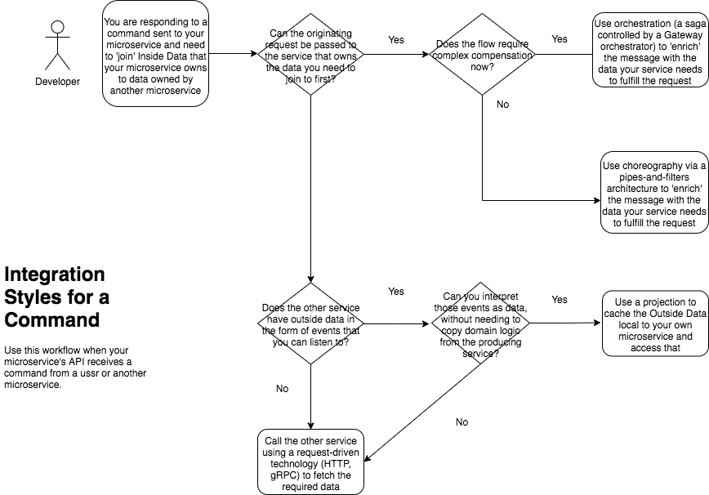
Commands
Notes:
When your microservice needs to ‘join’ with data from another microservice to service a command, it has a number of options to retrieve the data.
First, you can use a pipes and filters architectural style and populate the command with all the data that you need to service it. To do this you may need to pass the command through several other microservices before it reaches you. If that ‘flow’ is not complex you can use choreography i.e. each service is a ‘filter’ and knows how to listen to an enrich the command on its way to the destination but nothing knows the pipeline. If the flow is complex, you may need to provide orchestration i.e. a saga, that manages the flow of the command as it moves through other microservices.
Second, you can use

Slide 30
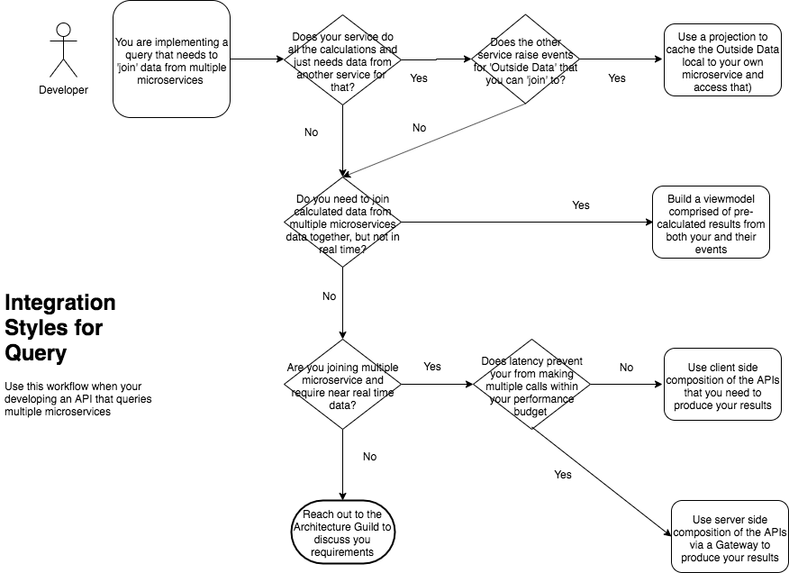
Queries

Slide 31
Smart Endpoints and Dumb Pipes
Notes:
“The microservice community favours an alternative approach: smart endpoints and dumb pipes. Applications built from microservices aim to be as decoupled and as cohesive as possible - they own their own domain logic and act more as filters in the classical Unix sense - receiving a request, applying logic as appropriate and producing a response.
The problem with the saga, as opposed to choreography is that it moves logic into the saga, so the endpoints become dumber, at risk of becoming entity services controlled by an orchestrator
”

Slide 32
The Entity Service Sniff Test
See Avoiding the Entity Service, Michael Nygard
Notes:
We need to be cautious of modeling microservices by looking for entities in our system and wrapping them with an API. This model tends to result in ‘feature envy’ as the business process logic creeps out of the service and into a Gateway orchestrator. Often this creates temporally coupled services, or the need to copy a lot of data in projections between services. By focusing on a process we can make our services more self-contained and more effectively use messaging to communicate.
Sometimes things just are an entity service, but they tend to be sources of reference data cached locally by other services to do their work

